Slide 1
A quick introduction to Ethereum
2019
github.com/jgege/FTalk2019feb
in/gergelyjuhasz92

Slide 2
What is Ethereum?
decentralised platform that runs smart contracts
public, open-source
powerful shared global infrastructure that can move value around and represent the ownership of property
inspired by Bitcoin

Slide 3
Ethereum Basics
Cryptocurrency
Ether
Consensus mechanism
Proof-Of-Work (it will change soon to Proof-Of-Stake)
Uses “gas” for pricing transactions (important because of smart contracts)
Account types (address has the same format)
Externally Owned Account (EOA)
Public and private key
Contract

Slide 4
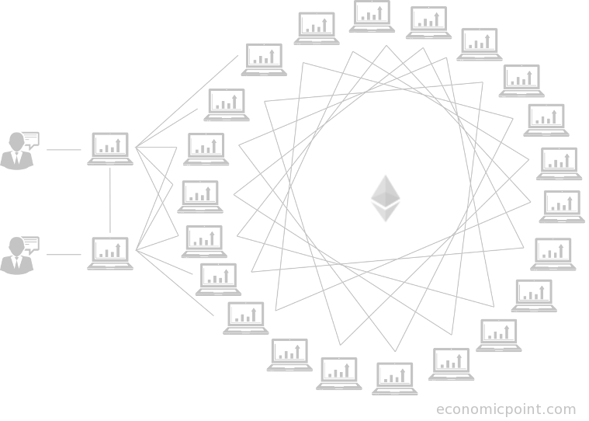
The Ethereum network
Create transaction
Sign it using the private key
Pass it to the neighbours
Each neighbour do some basic validation
Eventually a miner node will receive it
They will choose the ones that worth more (higher gas price)
Execute the transaction
Include it in the block

Slide 5
Transactions
Nonce | A sequence number, issued by the originating EOA, used to prevent message replay
Gas price | The price of gas (in wei) the originator is willing to pay
Gas limit | The maximum amount of gas the originator is willing to buy for this transaction
Recipient | The destination Ethereum address
Value | The amount of ether to send to the destination
Data | The variable-length binary data payload
v,r,s | The three components of an ECDSA digital signature of the originating EOA

Slide 6
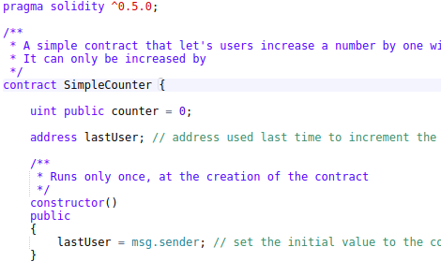
Smart Contracts
The Ethereum Virtual Machine
Byte code
https://medium.com/@blockchain101/solidity-bytecode-and-opcode-basics-672e9b1a88c2
Solidity
https://solidity.readthedocs.io/en/v0.5.3/index.html
Compiled to EVM bytecode
Many other languages
Vyper
LLL
Serpent

Slide 7
Smart Contract Development
MetaMask - http://metamask.io
Easy way to connect to the network (even without downloading it)
Remix IDE - https://remix.ethereum.org
Online code editor with great features
Truffle Suite - https://truffleframework.com
Truffle framework - helps with compiling and deploying smart contracts
Ganache - simulated Ethereum blockchain with nice settings (GUI & CLI)
Drizzle - Frontend framework to help you create GUI for your application

Slide 8
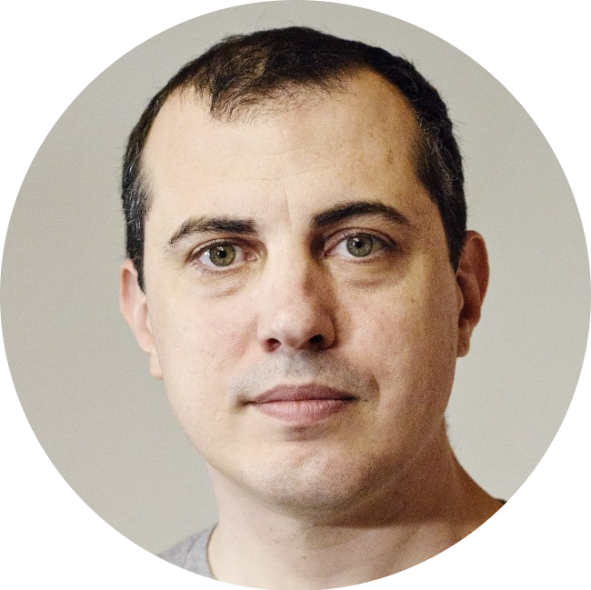


People worth following
Andreas Antonopoulos @aantonop
Vitalik Buterin @VitalikButerin
Kris Bennett in/kbennett2000

Slide 9
Resources
Ethereum project’s website - https://www.ethereum.org/
Mastering Ethereum - https://ethereumbook.info - by Andreas M. Antonopoulos, Gavin Wood
Dapp University (Youtube channel)
Ethereum Blockchain Developer: Build Projects Using Solidity - https://www.udemy.com/blockchain-developer
OpenZeppelin - https://openzeppelin.org/
Enterprise Ethereum Alliance - https://entethalliance.org/
Blockchain Training Alliance - https://blockchaintrainingalliance.com/

Slide 10
Any questions before the demo?

